Slide 1






Lecture 08
Advanced Operating Systems
CT4005NI - Computer Hardware and Software Architectures

Slide 2
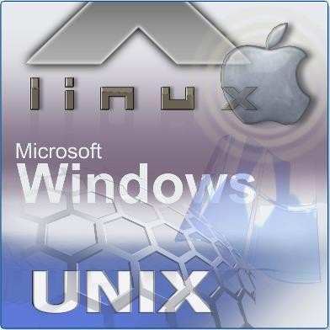
8. Introduction
The installation, configuration, and optimization of operating systems (OS) are examined in greater detail.
Objectives
Select the appropriate operating system based on customer needs.
Install, configure, and optimize an operating system.
Describe how to upgrade operating systems.
Describe preventive maintenance procedures for operating systems.
Troubleshoot operating systems.

Slide 3
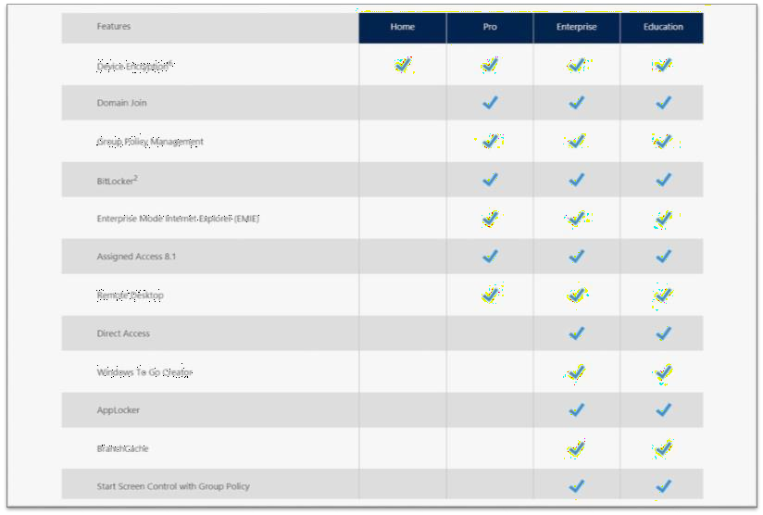
8.1 Select the appropriate operating system
There are many operating systems to choose from, each with features that should be considered when consulting with a customer.

Slide 4
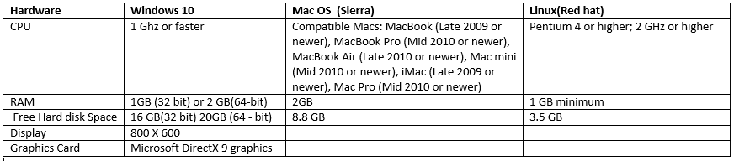
8.1.1 Operating System Description
Operating systems have minimum requirements for hardware.

Slide 5
8.1.2 Network OS Description
A NOS is an operating system that contains additional features to increase functionality and manageability in a networked environment. Examples: Windows 2016 Server, Linux, Unix, Novel NetWare and so forth.
NOS provides network resources to clients
Server applications, such as shared databases
Centralized data storage
Directory services that provide a centralized repository of user accounts and resources on the network, such as Active Directory.
Network print queue
Network access and security
Redundant storage systems, such as RAID and backups

Slide 6
8.1.2 Network OS Description
Network operating systems provide several protocols designed to perform network functions.
HTTP: defines how files are exchanged on the web.
FTP : Provides services for file transfer and manipulation.
POP : Retrieves e-mail message from a e-mail server.
DNS : Resolves URL to IP addresses.
DHCP: Automates assignment of IP addresses.
SMTP: SMTP is used to send and receive email.

Slide 7
8.1.3 Windows OS Directory Structures
During installation, the Windows setup program creates directories that have specific purposes.
_{User} Files Locations
By default, Windows stores most of the files created by the user in the folder.
Location:
C:\Users\User_name\My Documents
All users of a single computer have their own My Documents folder containing each user’s favorites, cookies, and
desktop items.

Slide 8
8.1.3 Windows OS Directory Structures
System
File Locations
All of the files that are used to run the computer are located in the folder.
Location:
C:\Windows\system32 for Windows XP , Windows Vista, Window7 and windows 10
Fonts
The Fonts folder contains all of the fonts that have been installed in the computer.
Font formats: TrueType, OpenType, Composite, and PostScript.
All of the installed fonts are located in C:\Windows\Fonts.

Slide 9
8.1.3 Windows OS Directory Structures
Temporary Files
The Temporary Files folder contains files created by the operating system and programs that are needed
for a short period of time.
For Examples: During program installation
C:\Users\User_name\AppData\Local\Temp : Run: %temp%
C:\Windows\Temp Run: temp
Program _{Files}
The Program Files folder is used by most application installation programs to install software.
C:\Program Files.

Slide 10
8.1.3 Windows OS Directory Structures
Offline Files and Folders
Offline Files and Folders allows you to select shared files and folders from the network to be stored on your computer.
These files are available after the computer is disconnected from the network.
When you reconnect to the network, the changes that you have made offline are
automatically applied to the original files on the network.
Window XP and others - C:\Windows\CSC

Slide 11
8.2 Install, Configure, and Optimize OS
Default Installation vs Custom Installation
Default installation is sufficient for computers in SOHO network.
Custom Installation is typically used in large network computers.
Default Installation requires minimal user interaction.
In Windows XP Custom installation is similar to default, as only two screens are there for
custom selection.
Regional Settings and Network Settings.

Slide 12
8.2 Install, Configure, and Optimize OS
8.2.2 Installing Windows - Custom Installation
Following are different types of custom installation,
^{An Unattended} installation from a network distribution point uses an answer file.
^{An} Image-based installation using a disk-imaging program copies an image of the operating system directly to the hard drive with no user intervention.
_{A Remote} installation using Remote Installation Services (RIS) downloads the installation
•
across the network.
•
_{An OS} Deployment Feature Pack using Microsoft System Management dramatically
simplifies deployment of an operating system across the organization.

Slide 13
8.2 Install, Configure, and Optimize OS
_{Unattended} Installation Windows_{XP}
The unattended installation using an unattend.txt answer file is the easiest custom installation method to
perform on a network.
WindowsVista
The System Image Manager (SIM) is used to create the setup answer file.
The Windows SIM is part of the Windows Automated Installation Kit (AIK) and can be downloaded from the
Microsoft website.
In Window7 different tools like AIK, vlite, nlite are available to create answer file.

Slide 14
8.2 Install, Configure, and Optimize OS
Image-based Installation
It begins by completely configuring one computer to an operational state.
Next, run Sysprep to prepare the system for imaging.
A third-party drive imaging application prepares an image of the completed computer, which can be burned onto a CD or DVD.

Slide 15
8.2 Install, Configure, and Optimize OS
Remote Installation
We can use RIS to remotely setup new Microsoft Windows computers.
They uses RIS network shared folder as the source of the windows OS files.
User computers that are connected to the network can be started by using a remote boot disk or network
adapter capable of booting the computer.
RIS is designed to be used in a relatively small network, whereas Microsoft SMS OS Deployment Feature allows the installation of a large number of client computers across an entire network concurrently.

Slide 16
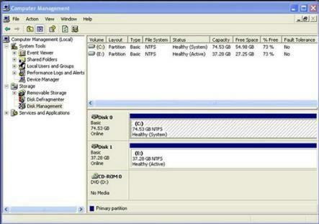
8.2.3 Managing Disks, Directories, and Files
Disk Structure
A hard disk is divided into specific areas called partitions.
_{The Disk} Management utility displays information and performs Services such as partitioning and formatting disks in Windows.
Partition types: Primary, Active, Extended.
_{Ways} to Access:
Select Start > right-click My Computer > Manage > Disk Management.
Select Start > Settings > Control Panel > Administrative Tools > Computer Management > Disk Management.
Open Run > diskmgmt.msc

Slide 17
8.2.3 Managing Disks, Directories, and Files
Disk Structure
In Windows, letters are used to name the drives.
A Windows computer can have up to 26 physical and logical drives because there are 26 letters in the English alphabet.
Drive A and B are reserved for Floppy drive and C is reserved for primary partition.
Mounted Drive
With the NTFS file system, a drive can be mapped to an empty folder on a volume and is referred to as a
mounted drive.

Slide 18
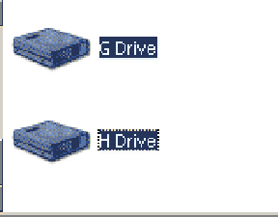
8.2.3 Managing Disks, Directories, and Files
Mounted Drive
Mounted drives are assigned drive paths instead of letters and are displayed as a drive icon.
Open Disk Management.
Right-click the partition or volume to be mounted.
Click Change Drive Letter and Paths.
Click Add.
Click Mount in the following empty NTFS folder.
Create an empty folder, type the path to an empty folder, or browse to an empty folder on an NTFS volume and click OK.
Close Computer Management.

Slide 19
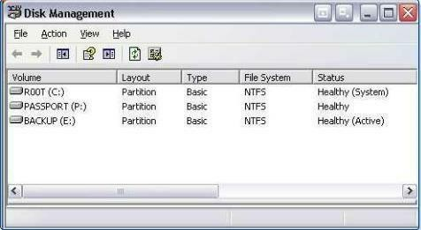
8.2.3 Managing Disks, Directories, and Files
Drive Status
The Disk Management utility displays the status of each disk.
Foreign – A disk that has been moved to a computer from another computer
Healthy – A volume that is functioning properly
Initializing – A basic disk that is being converted into a dynamic disk
Missing – A dynamic disk that is corrupted, turned off, or disconnected
Not Initialized – A disk that does not contain a valid signature
Unreadable – A basic or dynamic disk that has experienced hardware failure, corruption, or I/O errors

Slide 20
8.2.3 Managing Disks, Directories, and Files
Drive Status
Other Drive Status
Audio CD – An audio CD that is in the optical drive
No Media – An optical or removable drive that is empty

Slide 21
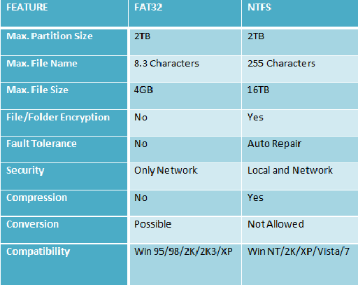
8.2.3 Managing Disks, Directories, and Files
File System
Partitions are formatted with a file system.
The file systems available in Windows are (FAT16), FAT32, and NTFS.
NTFS has greater stability and security featur
FAT
es.

Slide 22
8.2.4 Optimizing Performance of OS
Several procedures and tools are available to optimize the performance of an operating system.
Disk Error-Checking Tool
The Windows operating system uses CHKDSK from, within the GUI or at the command line to detect and repair
disk errors.
Steps for using the GUI
Double-click My Computer.
Right-click the drive that you want to check.
On the Tools tab, under Error-checking, click Check Now.
Under Check disk options, select the Scan for and attempt recovery of bad sectors check box.

Slide 23
8.2.4 Optimizing Performance of OS
Disk Error-Checking Tool
Steps for using the CLI
chkdsk – Displays a status report of the drive
chkdsk /f – Fixes errors on the disk
chkdsk /r – Recovers readable information from bad sectors
chkdsk /x – Dismounts the volume if necessary

Slide 24
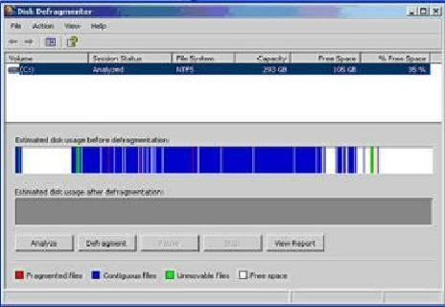
8.2.4 Optimizing Performance of OS
Disk Defragmenter
To help optimize the files on the hard drive.
It can consolidate files for faster access.
Defragmentation ^{Steps:}
Double-click My Computer.
Right-click the drive that you want to optimize.
Choose Properties.
In Tools tab, click Defragment Now.

Slide 25
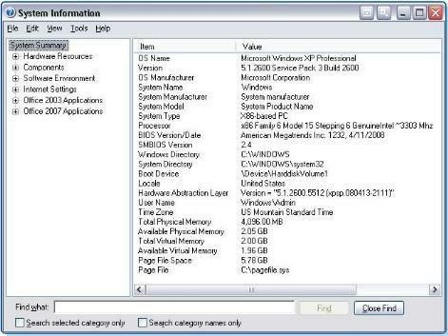
8.2.4 Optimizing Performance of OS
System Information
Administrators can use the System Information tool to collect and
display information about local and remote computers.
Finds information about software, drivers, hardware configurations,
and computer components.
Steps to Access: Open Run > msinfo32
To export a System Information file, click File > Export
To view the information from a remote computer choose
View>Remote Computer.

Slide 26
8.2.4 Optimizing Performance of OS
Remote Desktop Protocol
The Remote Desktop Protocol allows you to use an application such as Remote Desktop or Remote Assistance to connect to another computer.
These applications allow you to view the screen and control the computer’s mouse and keyboard as though you were
local to that computer.
The Remote Desktop Protocol is also used to operate computers that are connected to the network but do not have a
monitor, mouse, or keyboard.
In XP/Win7 : Start > All Programs > Accessories >Remote Desktop Connection
Remote Assistance uses the Remote Desktop Protocol to allow another user to connect to your computer, see your
computer screen, and chat over a network.

Slide 27
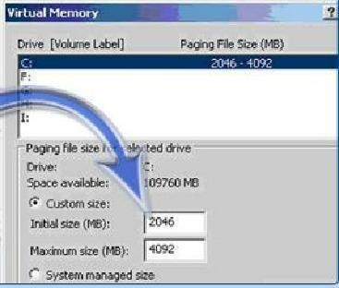
8.2.4 Optimizing Performance of OS
Virtual Memory
Virtual memory allows the CPU to address more memory
than is installed in the computer.
Virtual memory is a swap or page file that is constantly read in and out of RAM.
Typically, one should let Windows manage the size of the swap file.
In XP/Win7 : Start > Control Panel > System > Advanced tab > Performance, click Settings
button > Advanced tab

Slide 28
8.2.4 Optimizing Performance of OS
Administrative Tools
Computer Management – This tool allows you to access administrative areas such as
System Tools, Storage, and Services and Applications.
Event Viewer – This tool logs a history of events regarding applications, security, and the system.
Services – This tool allows you to manage all of the services on local and remote
computers.
_{Performance} Monitor – This tool displays and logs real-time information about the processors,
disks, memory, and network usage for the computer.

Slide 29
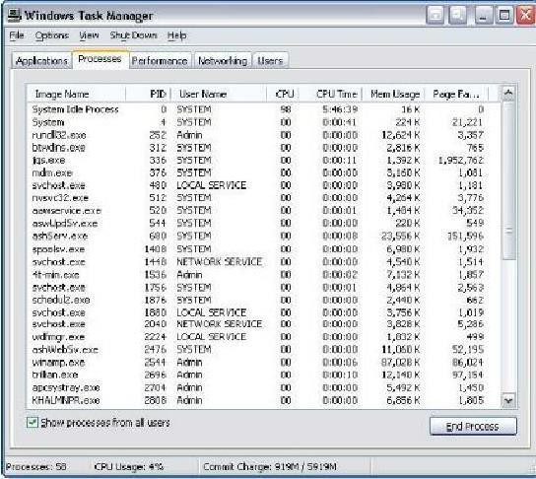
8.2.4 Optimizing Performance of OS
Task Manager
The Task Manager allows you to view information
about applications that are currently running.

Slide 30
8.2.4 Optimizing Performance of OS
Task Manager
There are five tabs within the Task Manager
Applications – This tab shows all of the applications that are running.
Processes – This tab shows all of the processes that are running.
^{Performance}– This tab shows the CPU and page file usage of the computer.
^{Networking}– This tab shows the usage of all network adapters in the computer.
^{Users}– This tab shows all users that are logged on the computer.

Slide 31
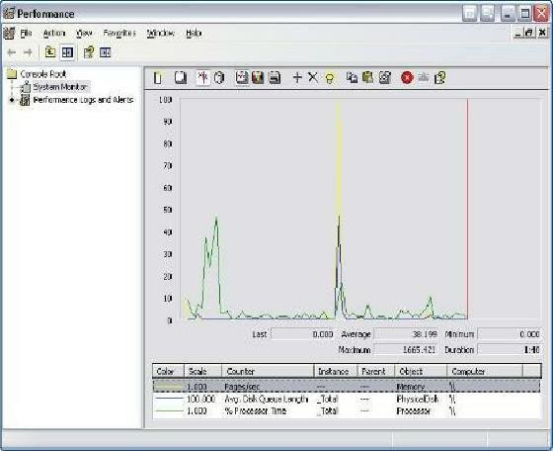
8.2.4 Optimizing Performance of OS
System Monitor
The System Monitor is part of the Performance Console and displays real-time information about the processors, disks, memory, and network usage of the computer.
You can easily summarize these activities through histograms, graphs, and reports.

Slide 32
8.2.4 Optimizing Performance of OS
Temporary Files
Almost every program uses temporary files, which are usually automatically deleted
when the application or the operating system is finished using them.
However, some of the temporary files must be deleted manually.
Location:
Windows
C:\Windows\Temp
C:\Users\%USERPROFILE%\AppData\Local\Temp

Slide 33
8.2.5 Optimizing Browsers Performance
The Microsoft browser, Internet Explorer (IE), has general settings for changing the homepage and browser
appearance settings.
Additional settings allow you to view or delete the information saved by the browser:
History •Temporary files •Cookies •Passwords •Web-form information
Cookies are information transmitted between a web browser and a web server with the purpose of tracking
user information.
Caching, or storing, Internet files is a feature of the web browser that is used to speed up the process of accessing previously visited websites.

Slide 34
8.2.6 Configuring E-mail Software
Outlook Express is an e-mail tool that is a component of the Microsoft Windows operating system.
You should have the following information available when installing e-mail accounts into the e-mail client software:
Display name
E-mail address
Type of incoming mail server
Incoming mail server name
Outgoing mail server name
Username
Account password
The Protocols used in email contains - POP3, IMAP, SMTP, MIME.

Slide 35
8.2.7 Select Screen Resolution and Update Video Driver
After the operating system is installed, you can set the screen resolution to meet the requirements of your customer.
You can change the screen settings in Windows in the Settings tab of the Display
Properties control panel applet:
Screen resolution – This setting determines the number of pixels.
Refresh rate –
Display colors –
This setting determines how often the image in the screen is redrawn.
This setting determines the number of colors visible on the screen at once.

Slide 36
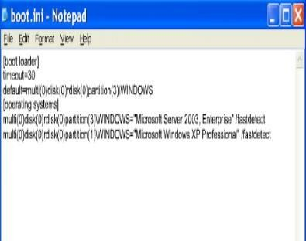
8.2.8 Installing Second OS
To create a dual-boot system in Microsoft Windows, you typically must have
more than one hard drive, or the hard drive must contain more than one
partition.
You should install the oldest operating system on the primary partition or the hard drive marked as the active partition first.
You should then install the second operating system on the second partition or hard
drive.
The boot.ini File
During the installation, the boot.ini file is created on the active partition to allow the selection of the operating system to boot on startup.
The boot.ini file can be edited to change the order of the operating systems.

Slide 37
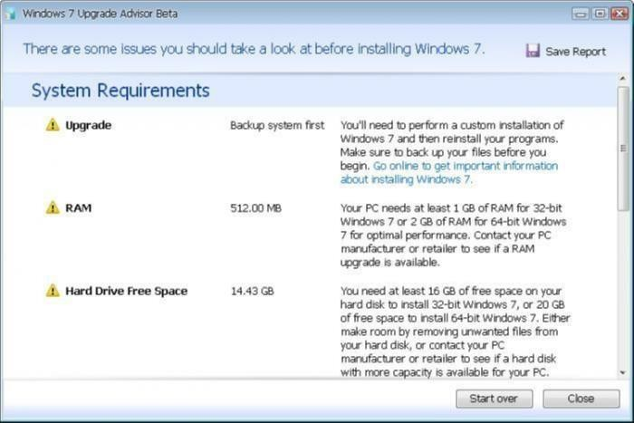
8.3 Upgrading OS
An operating system must be upgraded periodically to
remain compatible with the latest hardware and
software.
Microsoft _{provides} a utility called the Upgrade Advisor to scan the system for incompatibility issues.
You can download the Upgrade Advisor from the Microsoft Windows website free of charge.

Slide 38
End of Lecture 8

